Slide 1
Electric Motor Temperature
Priyanka
Nidhi
Namitha
Predict Motor Speed based on other attributes available
Rahul
Dibyanshu
Yasaswitha

Slide 2
Data Set Details:
Temperature Data set
Feature set:
ambient
Ambient temperature as measured by a thermal sensor located closely to the stator.
coolant
Coolant temperature. The motor is water cooled. Measurement is taken at the outflow.
u_d
Voltage d-component
u_q
Voltage q-component
motor speed
Motor speed
torque
Torque induced by current.
I'd
Current d-component
i_q
Current q-component
pm
Permanent Magnet surface temperature representing the rotor temperature. This was measured with an infrared thermography unit.
stator yoke
Stator yoke temperature is measured with a thermal sensor.
stator tooth
Stator tooth temperature is measured with a thermal sensor.
stator winding
Stator winding temperature measured with a thermal sensor.
profile_id
Each measurement session has a unique ID. Make sure not to try to estimate from one session onto the other as they are strongly independent.

Slide 3
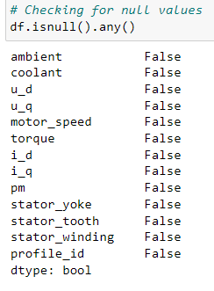
1)Exploratory Data Analysis(EDA)
2)Model Building
3)Model Evaluation
4)Model Deployment
1)Exploratory Data Analysis:
To summarize their Values: outliers,
Missing values, univariate Analysis,
pair plot, Density plot,
Correlation Analysis

Slide 4
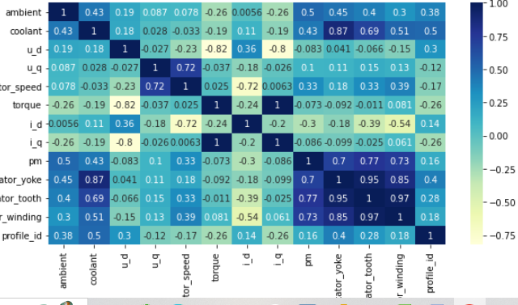
Correlation matrix
Libraries
Numpy
Pandas
Matplotlib
Seaborn

Slide 5
2)Model Building:
Building the model with training data set by using different Machine learning Algorithms
Y(Dependent variable)= Motor speed
X(Independent Variables)=currents,Motor speed,coolant and ambient Temperature
Libraries:
Scikit learn

Slide 6
Models:
Linear Regression
Random Forest
XG Boost
Ada Boost
Elastic Net
Decision Tree
KNN
Bragging
Gradient Boosting

Slide 7
3)Model Evaluation:
In Temperature data set all features are continuos values , So for Evaluation we are Calculated .
Accuracy,
R2 value,
Adjusted R2,
Mean Square Error,
Root mean square Error,
Root mean log error

Slide 8
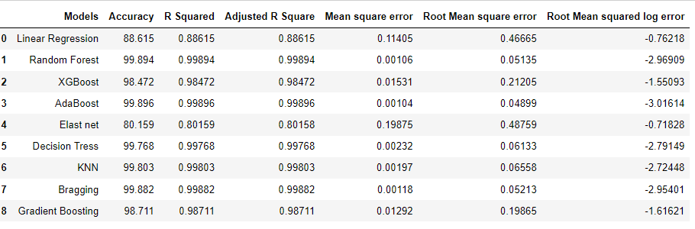
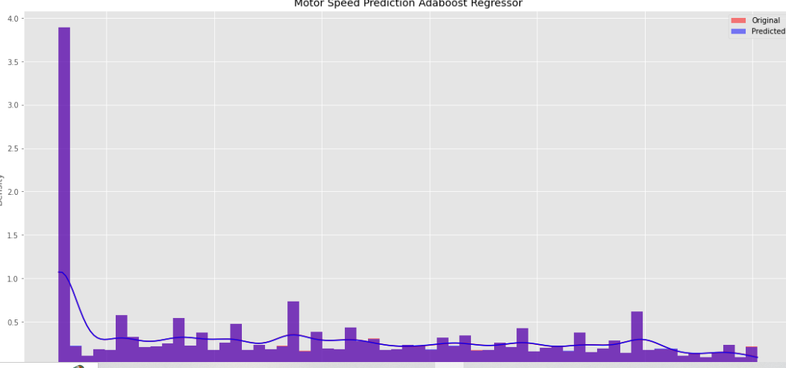
AdaBoost:

Slide 9
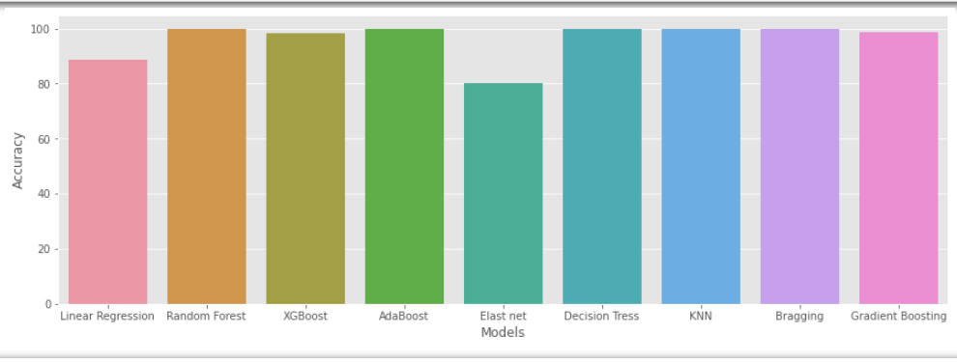
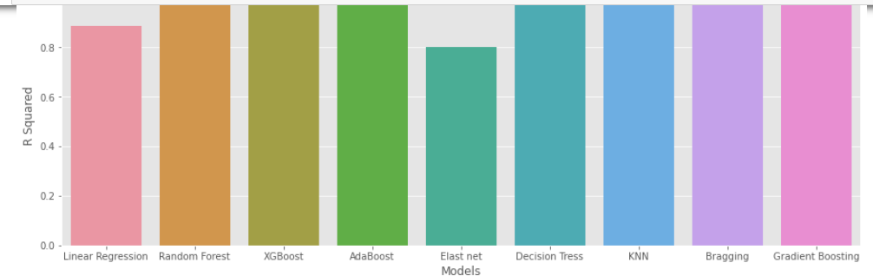

Slide 10
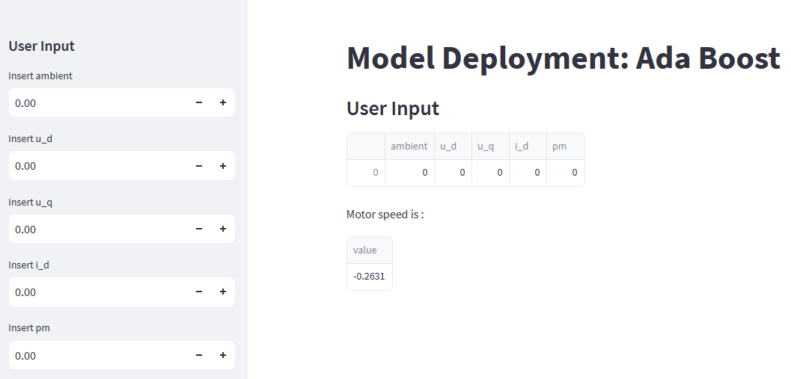
4)Model Deployment:
Stream Lit library

Slide 11
Thank you

